Slide 1
Multiple Comparisons and p-hacking
Kathleen Torkko
October 30, 2019

Slide 2
Objectives
Learn what FWER and FDR are
Learn how to do it in Prism
Understand why multiple testing is not a good idea
Understand what p-hacking is why we want to avoid it.

Slide 3
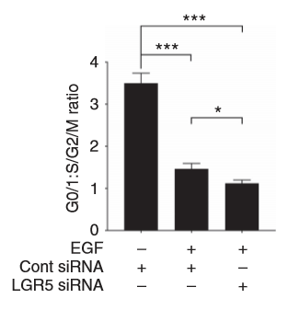
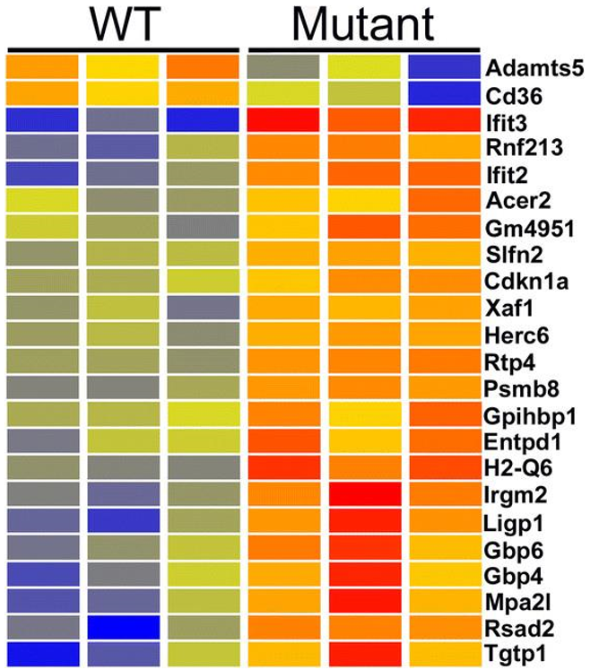
Multiple Testing: Two Types
Big data experiments with a large number of independent tests on the same samples
Multiple tests instead of a global test
e.g., multiple independent t-tests when an ANOVA is the appropriate test

Slide 4
Why worry about multiple testing (comparisons)?
In classical hypothesis testing, the “alpha level” describes how willing a researcher is to make a Type I error (false positive)
Falsely rejects a true null hypothesis
With α=0.05 the researcher is “willing” to commit a Type I error 5% of the time
With one tests there is a 5% probability that we made a Type I error

Slide 5
Type 1 error rate in multiple testing
if we perform m hypothesis tests, what is the probability of at least 1 false positive?
P(Making an error) = α
P(Not making an error) = 1 - α
P(Not making an error in m tests) = (1 - α)^{m}
P(Making at least 1 error in m tests) = 1 - (1 - α)^{m}

Slide 6
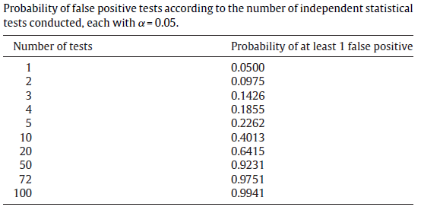
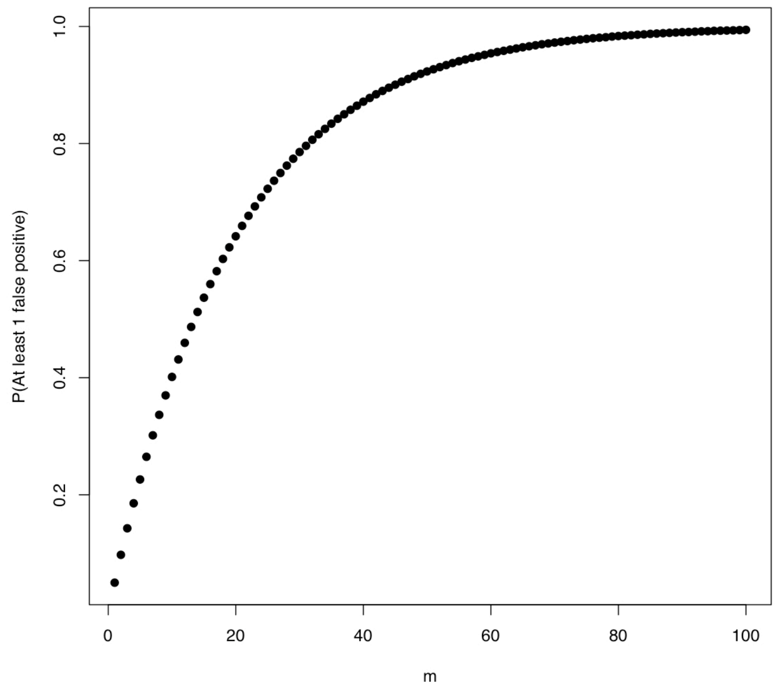
Type 1 error rate in multiple testing
If alpha (Type I error rate, AKA level of significance) = 0.05 and there are 3 comparisons to be made, the Type I error rate changes:
1−(1−0.05)³ = 14.3%
Instead of a 5% probability of a Type I error with one test, there is a 14.3% probability that at least one of the three tests is a false positive
Probability of At Least 1 False Positive

Slide 7
Example
You compare control and treated animals, and you measure the level of three different enzymes in the blood plasma.
You perform three separate t-tests, one for each enzyme, and use the traditional cutoff of alpha=0.05 for declaring each p value to be significant. Even if the treatment doesn't actually do anything, there is a 14% chance that one or more of your t tests will be “statistically significant”.
If you compare 10 different enzyme levels with 10 t-tests, the chance of obtaining at least one “significant” p value by chance alone, even if the treatment really does nothing, is 40%.
Finally, imagine that you test 100 different enzymes, at 10 time points, with 12 pre-treatments... If you don't correct for multiple comparisons, you are almost certain to find that some of them are 'significant', even if all null hypotheses are true.

Slide 8
Another way to look at it..
Genomics = Lots of Data = Lots of Hypothesis Tests
A typical microarray experiment might result in performing
10000 separate hypothesis tests.
If we use a standard p-value cut-off of 0.05, we’d expect 500 genes to be deemed “significant” by chance.

Slide 9
What can you do?
Use multiple comparison methods that find ways to bring the Type I error rate back to 5%
“Controlling” Type I error by “adjusting” p-values
Very active area of statistics - many different methods have been described
Also: Replication is helpful
If we are concerned that a finding is simply an artifact of sampling variability that we happened to discover because of a blind application of classical hypothesis testing, then the best way to resolve the question is to conduct the experiment again (and again)

Slide 10
Different Approaches To Control Type I Errors
Most apply a simple formula to a series of “raw” p-values
• Family-wise error rate: the probability of at least one type I error
Classic approach; more conservative
• False discovery rate (FDR) is the expected proportion of Type I errors among the rejected hypotheses
More popular recently – controls the average proportion of ‘false discoveries’
• Positive false discovery rate (pFDR): the rate that discoveries are False
• Per comparison error rate (PCER): the expected value of the number of Type I errors over the number of hypotheses,
• Per-family error rate (PFER): the expected number of Type I errors

Slide 11
What is the “family” in “family-wise”?
The term “familywise” error rate comes from family of tests, which is the technical definition for a series of tests (performing multiple hypotheses tests) on data
Example: you hypothesize that SNPs in the VDR gene are associated with prostate cancer. You genotyped 20 SNPs in people with and without prostate cancer. You do a chi-square test on the proportions of the at-risk genotype for each SNP individually by cancer yes/no. You have tested the same hypothesis 20 times.

Slide 12
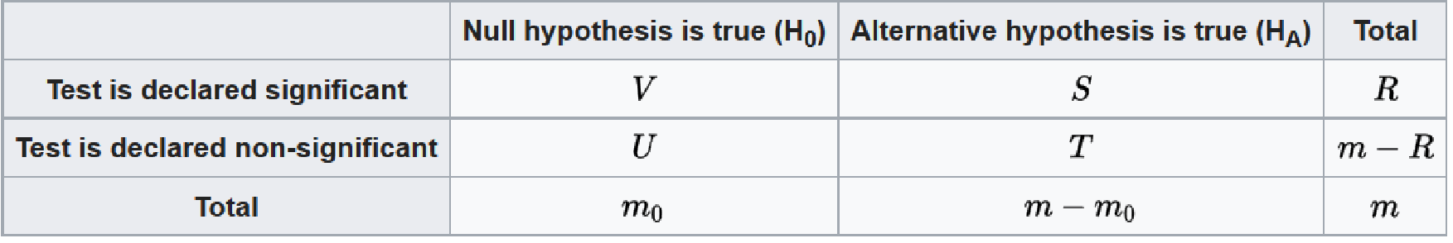
FWER vs. FDR
FWER: 𝑃𝑟𝑜𝑏𝑎𝑏𝑖𝑙𝑖𝑡𝑦(𝑉 ≥ 1)
Probability of making at least one incorrect rejection of a null hypothesis (a false positive)
FDR: 𝐴𝑣𝑒𝑟𝑎𝑔𝑒 𝑉 / R
Average proportion of false discoveries [the expected proportion of false discoveries among all discoveries (results with p<0.05 from statistical tests)]
Better when there are many multiple comparisons

Slide 13
FWER: The Bonferroni correction (1936)
Italian mathematician Carlo Emilio Bonferroni
Divide the α threshold for determining significance (typically 0.05) by the number of tests that were performed and use the resulting number as the new threshold.
New Threshold
4 comparisons α = 0.05/4 = 0.0125
10 comparisons α = 0.05/10 = 0.005
100 comparisons α = 0.05/100 = 0.0005
If the threshold is lowered in this way, the probability of finding at least one false positive result in any of the multiple statistical tests is 5%.
i.e., the family-wise error rate is controlled
Although easy to use, Bonferroni is very conservative
Increases risk of a Type II error (false negative)

Slide 14
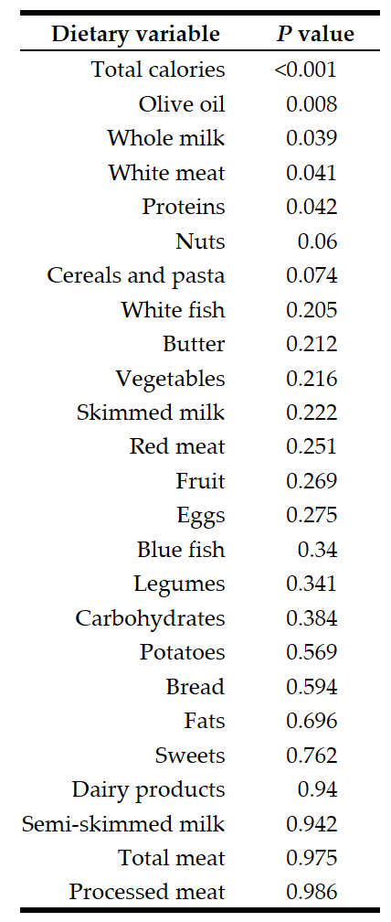
Example: García-Arenzana et al. (Int. J. Cancer: 134, 1916–1925 ; 2014) tested associations of 25 dietary variables with mammographic density, an important risk factor for breast cancer
Five of the variables have “raw” p<0.05
With multiple testing, with 25 dietary variables, 1 or 2 might be false positives
Bonferroni correction: divide 0.05 by the number of tests (25) to get the Bonferroni critical value
A test with a “raw” p<0.002 would now be statistically significant.
only the test for total calories is now considered significant

Slide 15
“Family” revisited
García-Arenzana tested 25 dietary variables, so are these tests one "family," making the Bonferroni critical p-value 0.05/25?
But they also measured 13 non-dietary variables such as age, education, and socioeconomic status; should they be included in the family of tests, making the critical p-value 0.05/38?
There are no firm rules on this; use your judgment, based on just how bad a false positive would be
Obviously, you should make this decision before you look at the results, otherwise it would be too easy to subconsciously (or consciously!) rationalize a family size that gives you the results you want

Slide 16
FDR example
You're using microarrays to compare expression levels for 20,000 genes between liver tumors and normal liver cells
You're going to do additional experiments on any genes that show a significant difference between the normal and tumor cells
You're willing to accept up to 10% of the genes with significant results being false positives
You'll find out they're false positives when you do the follow-up experiments.
You would set your false discovery rate to 10%.

Slide 17
Benjamini and Hochberg (1995) method to control FDR
Put the individual p-values in order, from smallest to largest.
The smallest p-value has a rank of i=1, then next smallest has i=2, etc.
Compare each individual p-value to its Benjamini-Hochberg critical value, (i/m)Q, where i is the rank, m is the total number of tests, and Q is the false discovery rate you choose.
The largest p-value that has p<(i/m)Q is significant, and all of the p-values smaller than it are also significant, even the ones that aren't less than their Benjamini-Hochberg critical value.

Slide 18
Which FDR value should I use?
Many people use 0.05, but…
If the cost of additional experiments is low and the cost of a false negative (missing a potentially important discovery) is high,
use a fairly high false discovery rate, like 0.10 or 0.20, so you don't miss anything important

Slide 19
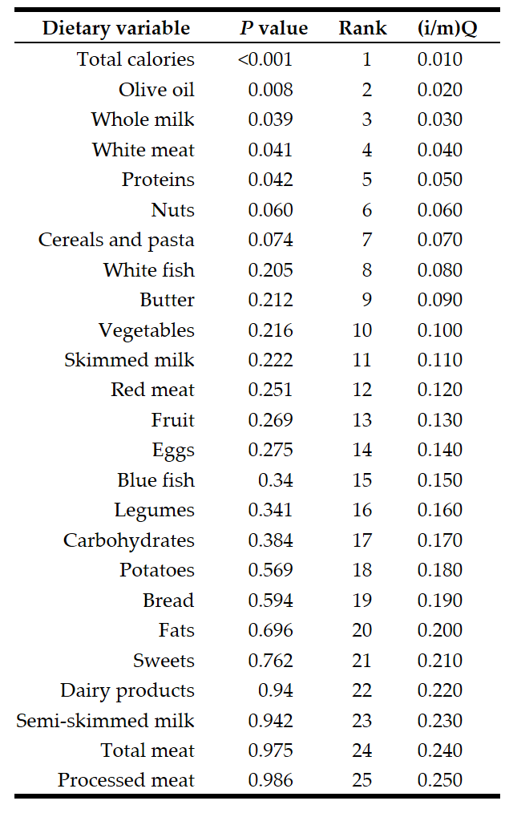
Reading down the column of p-values, the largest one with P<(i/m)Q is proteins, where the individual p-value (0.042) is less than the (i/m)Q value of 0.050. Thus the first five tests would be significant. Note that whole milk and white meat are significant, even though their p-values are not less than their Benjamini-Hochberg critical values; they are significant because they have p-values less than that of proteins.

Slide 20
Which p-values do I report” “raw” or adjusted?
Adjusted p-values are not really estimates of the probability (p) of anything
Give the raw p-values and say which are significant using the Benjamini-Hochberg procedure with your false discovery rate

Slide 21

Adjust or not to adjust: that is the question
More repeats and large sample size.
Applying a correction like Bonferroni may lead to an unnecessary loss of statistical power (Type II errors)
Applying no correction at all, will inflate the probability of false rejections of the null hypothesis (Type I errors)
The question is: on which side should we err?
Which is worse, a false positive or a false negative?
One way to help reduce false negatives is to have adequate sample size (power)
CORRECTED?

Slide 22
A case against controlling for multiple comparisons
A researcher measured only a single dependent variable, a p = 0.04 would have led to a decision to reject the null hypothesis,
Add a second dependent variable, the alpha level is reduced to 0.025, and now the same data no longer leads to the conclusion to reject the null hypothesis
Should the conclusions a researcher makes depend on the number of additional tests a researcher performs?
Lowering alpha levels is a mathematical necessity when you want to control error rates, but it is not needed if all you want to do is quantify relative likelihoods of the data under different hypotheses.

Slide 23
You've knocked out your favorite gene, mannose-6-phosphate isomerase (Mpi), in a strain of mice that spontaneously develop lots of tumors.
You measure 50 things on Mpi^{-/-} mice and normal mice, run the appropriate statistical tests, and the smallest p value is 0.013 for a difference in tumor size.
If you use a Bonferroni correction, that P=0.013 won't be close to significant; it might not be significant with the Benjamini-Hochberg procedure, either.
Should you conclude that there's no significant difference between the Mpi^{-/-} and Mpi^{+/+} mice, write a boring little paper titled "Lack of anything interesting in Mpi^{-/-} mice," and look for another project?
No, your paper should be "Possible effect of Mpi on cancer." You should be suitably cautious, of course, and emphasize in the paper that there's a good chance that your result is a false positive; but the cost of a false positive—if further experiments show that Mpi really has no effect on tumors—is just a few more experiments. The cost of a false negative, on the other hand, could be that you've missed out on a hugely important discovery.
But remember to relate this back to the measure of effect…

Slide 24
What is the recommendation regarding whether to correct for multiple tests?
“It all depends.”
If a small number of hypotheses have been stated a priori or if the purpose of the study is exploratory, then such corrections are probably not needed. However, in the absence of hypotheses, they may be required.

Slide 25
FDR and FWER methods for multiple comparisons in Prism
FDR
Prism offers 3 methods. The two stage step up method is recommended.
The FDR-adjusted p-values are also known as q-values.
FDR methods are more powerful
FWER methods
Prism also offers Bonferroni and more sophisticated methods – Bonferroni Sidak, Bonferroni Dunn, Holm Sidak. Holm Sidak is recommended.
For ANOVA, other methods, e.g. Tukey’s are available.

Slide 26
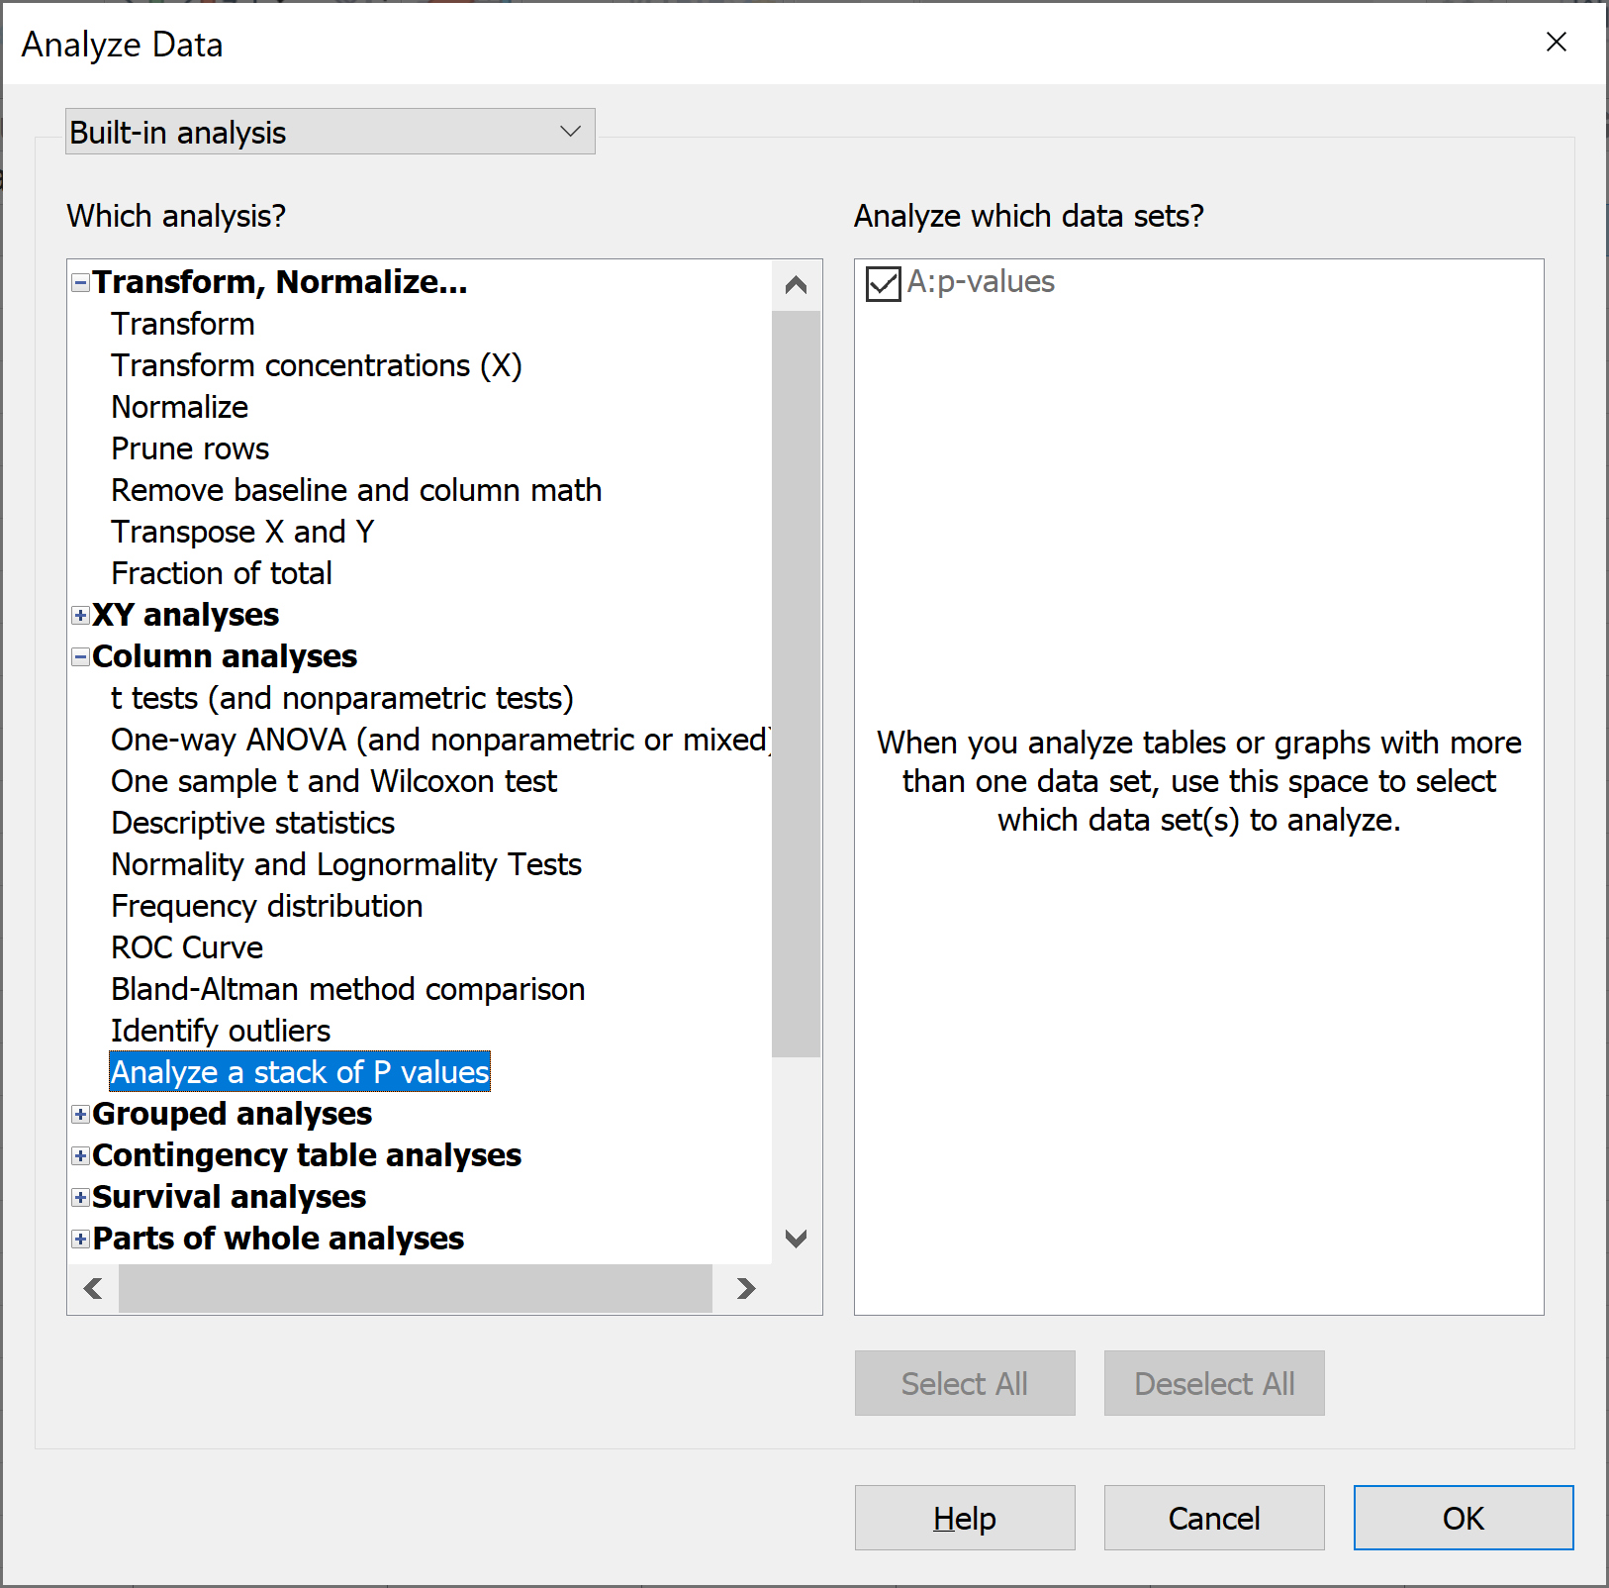
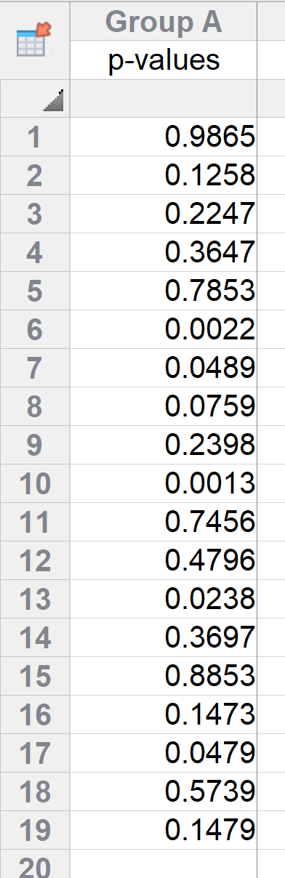
FDR and FWER: Stacked p-value analysis in Prism
Start with a Column table
Week10_StackedP-Values.xlsx

Slide 27
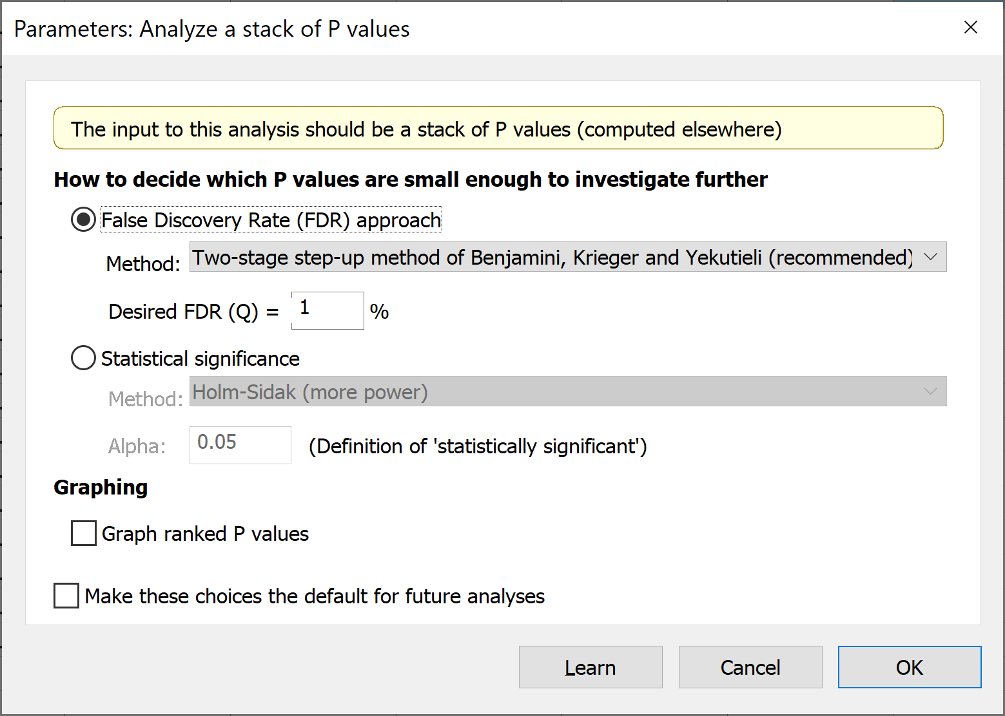
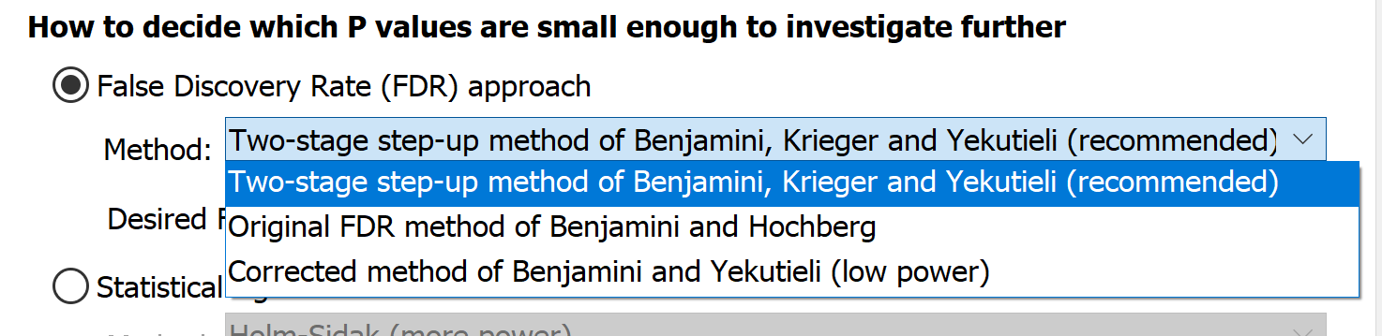

Slide 28
Control the False Discovery Rate (FDR)
Choose one of three approaches to decide which P values are small enough to flag as "discoveries".
Prism recommends the adaptive method of Benjamini, Krieger and Yekutieli as it has more power.
The original FDR method of Benjamini and Hochberg is better known, but has less power.
The method of Benjamini and Yekutieli makes fewer assumptions, but has much less power.

Slide 29
Set the value of Q (desired FDR)
no more than Q% of the comparisons flagged as discoveries, are false discoveries (false positives)
Enter a percentage, not a fraction.
5%: enter "5" not "0.05" and not "5%“
Really is no standard value
If you enter a larger value, more comparisons will be flagged as discoveries, but more of these will be false discoveries.

Slide 30
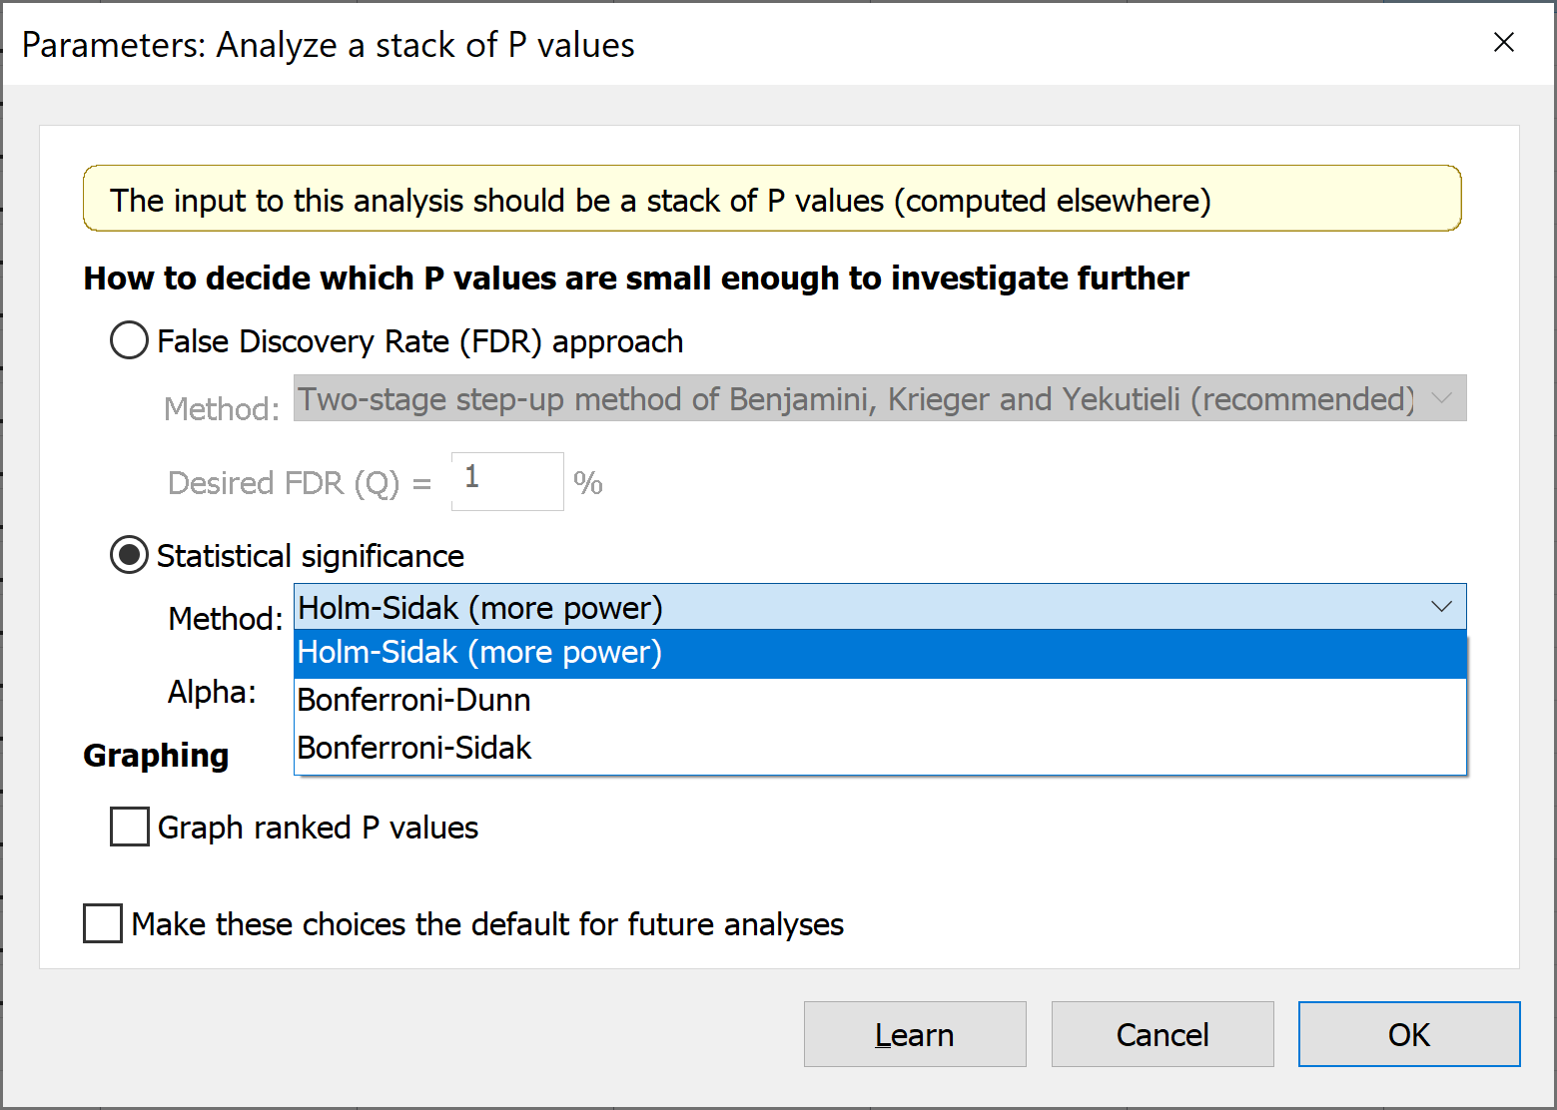
Statistical significance (control Type I error rate for the family of comparisons)
Choose how Prism will correct for multiple comparisons. Prism recommends using the Holm-Šídák method, which has the most power. The alternatives are the methods of Bonferroni-Dunn or Bonferroni-Šídák. The method we call Bonferroni-Dunn is often referred to simply as Bonferroni. The method we call Bonferroni-Šídák is often referred to simply as Šídák. The two are very similar. The Bonferroni-Šídák method has a bit more power but is less widely understood.

Slide 31
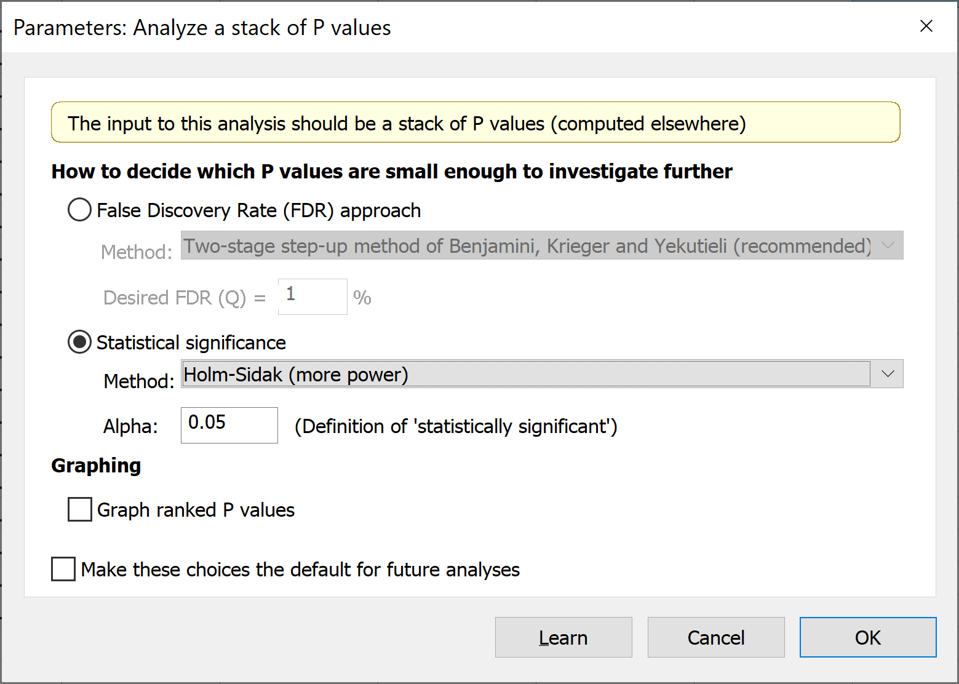
Set the value of alpha that applies to the entire family of P values.
Prism then decides which P values are small enough for the related comparison to be designated "statistically significant" after correcting for multiple comparisons.
Enter a fraction, not a percentage (i.e., 0.05 for 5% of comparisons under the null hypothesis to be falsely flagged as "significant“)
Enter a larger value, more comparisons will be flagged as "significant", but more of these will be false positives.

Slide 32
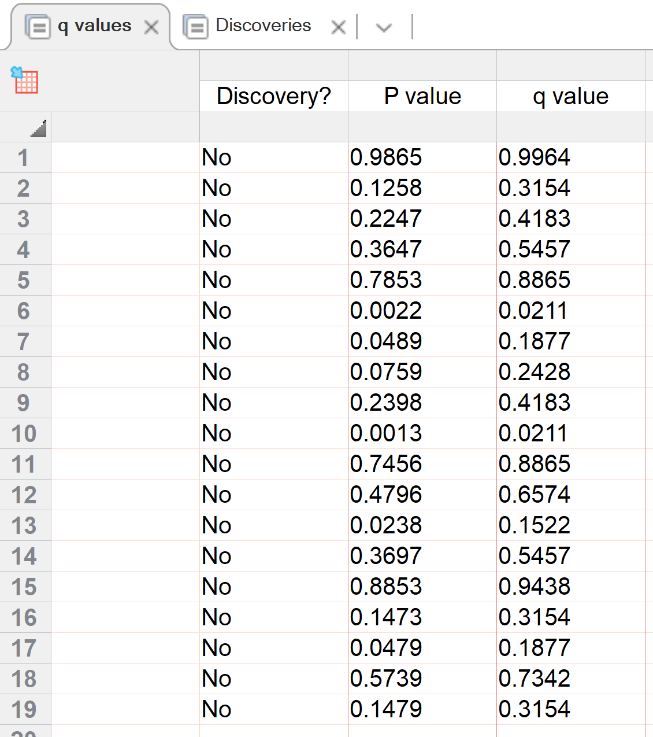
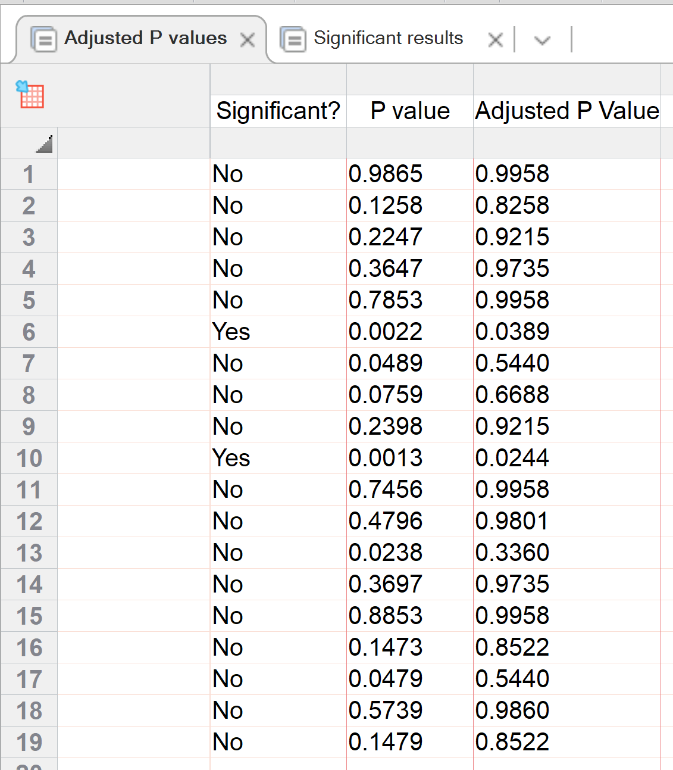

Slide 33
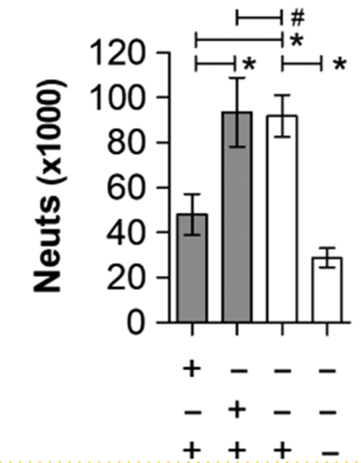
Researchers still commonly use multiple independent t-tests
Instead of a 5% probability of a Type I error with one test, there is a 14.3% probability that at least one of the three tests is a false positive
* = P < 0.05; # = P > 0.05. P value calculated from Student's T-test. Error bars show mean with SEM.
Polysaccharide-experienced effector T cells induce IL-10 in FoxP3⁺ regulatory T cells to prevent pulmonary inflammation. Glycobiology. 2017;28(1):50-58.
Notes:
Fig. 7. PSA-experienced Rb<sup>low</sup>Tem cells protect mice from leukocyte airway infiltration. WT mice were exposed to PSA or saline via oral gavage. PSA-experienced CD4<sup>+</sup> T cells were harvested, sorted into Rb<sup>low</sup>Tem and Rb<sup>hi</sup> populations, and 6 × 10<sup>4</sup> cells were adoptively transferred into OVA-sensitized WT recipients. On Day 7 of OVA or saline challenge, mice were sacrificed and lungs lavaged with saline. Recovered cells were analyzed by a Hemavet counter and plotted. PSA-experienced Rb<sup>low</sup> but not Rb<sup>hi</sup> T cells were able to prevent leukocyte infiltration into the airways. * = P < 0.05; # = P > 0.05. P value calculated from Student's T-test. Error bars show mean with SEM.
33

Slide 34
Why not compare groups with multiple t-tests?
Every time you conduct a t-test, there is a chance that you will make a Type I error.
With 6 t-tests, the Type I error rate is 26.5%
A global test like an ANOVA controls for these errors so that the Type I error remains at 5%

Slide 35
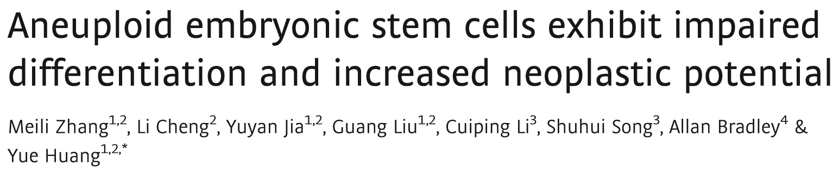
EMBO J. 2016 Nov 2; 35(21): 2285–2300
Statistical analysis
The data are shown as the means ± SD. A two‐tailed Student's t‐test was used to analyze significant differences. Welch's correction was used for variance heterogeneity. P < 0.05 was considered significant (*P < 0.05, **P < 0.01). The data analyses were performed using Prism GraphPad software.
Let’s play with data from this paper and look at two figures…..
Week08_AneuploidMultipleComparisons.xlsx

Slide 36
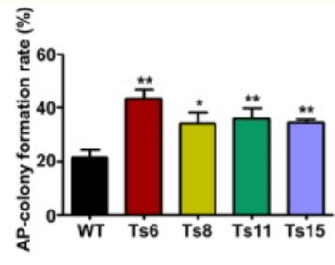
EMBO J. 2016 Nov 2; 35(21): 2285–2300
Fig 3A. The colony formation rates of the trisomic and wild‐type ES cells. Error bars, ± SD. n = 3. *P < 0.05, **P < 0.01.

Slide 37
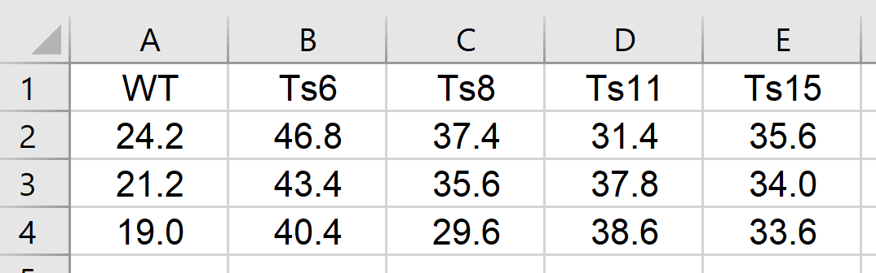
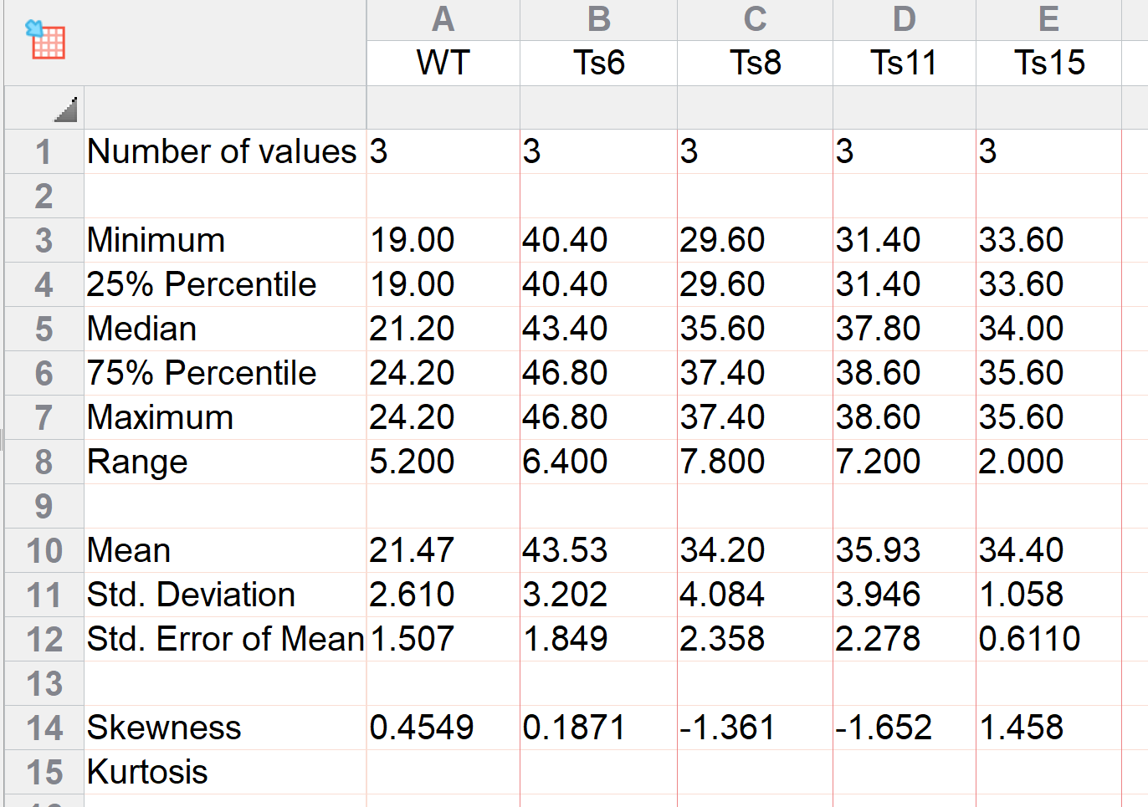
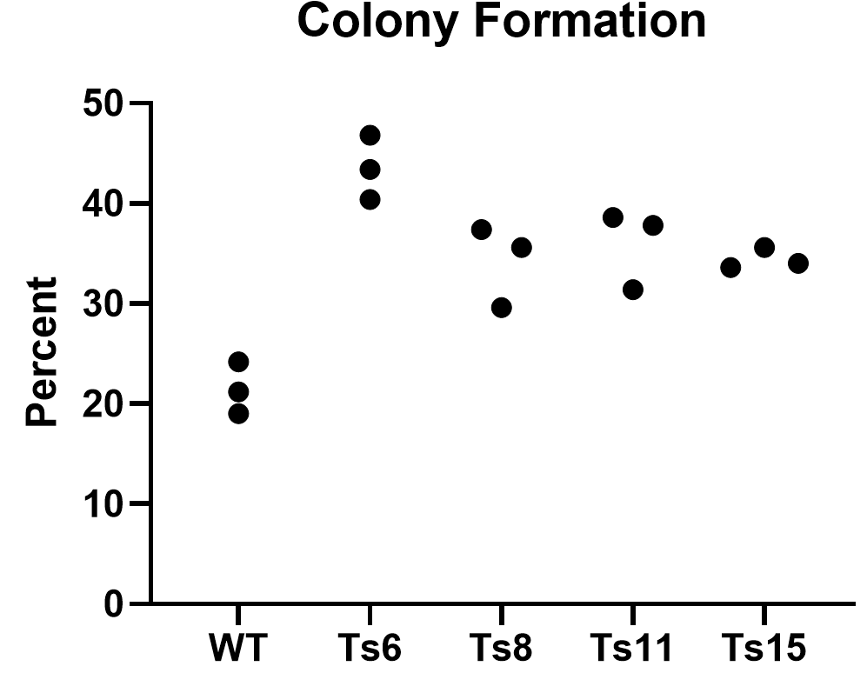
Homoscedasticity?

Slide 38
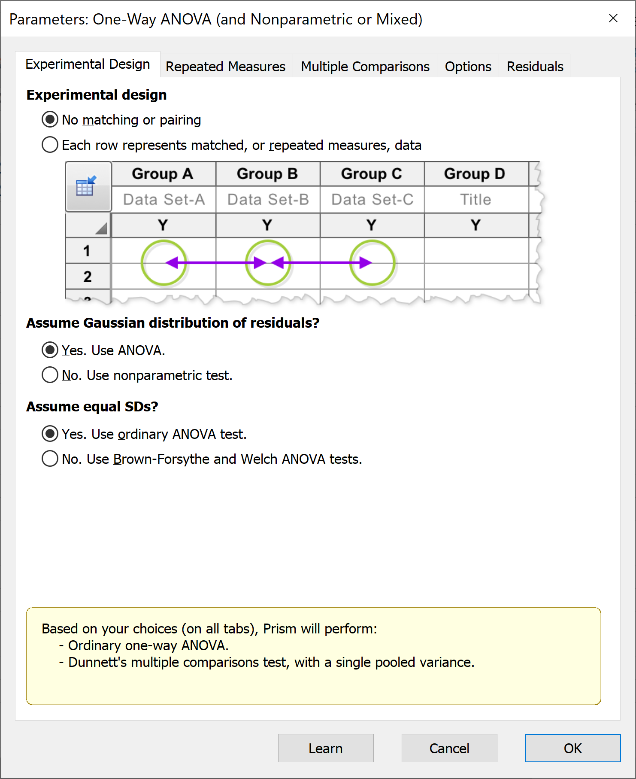
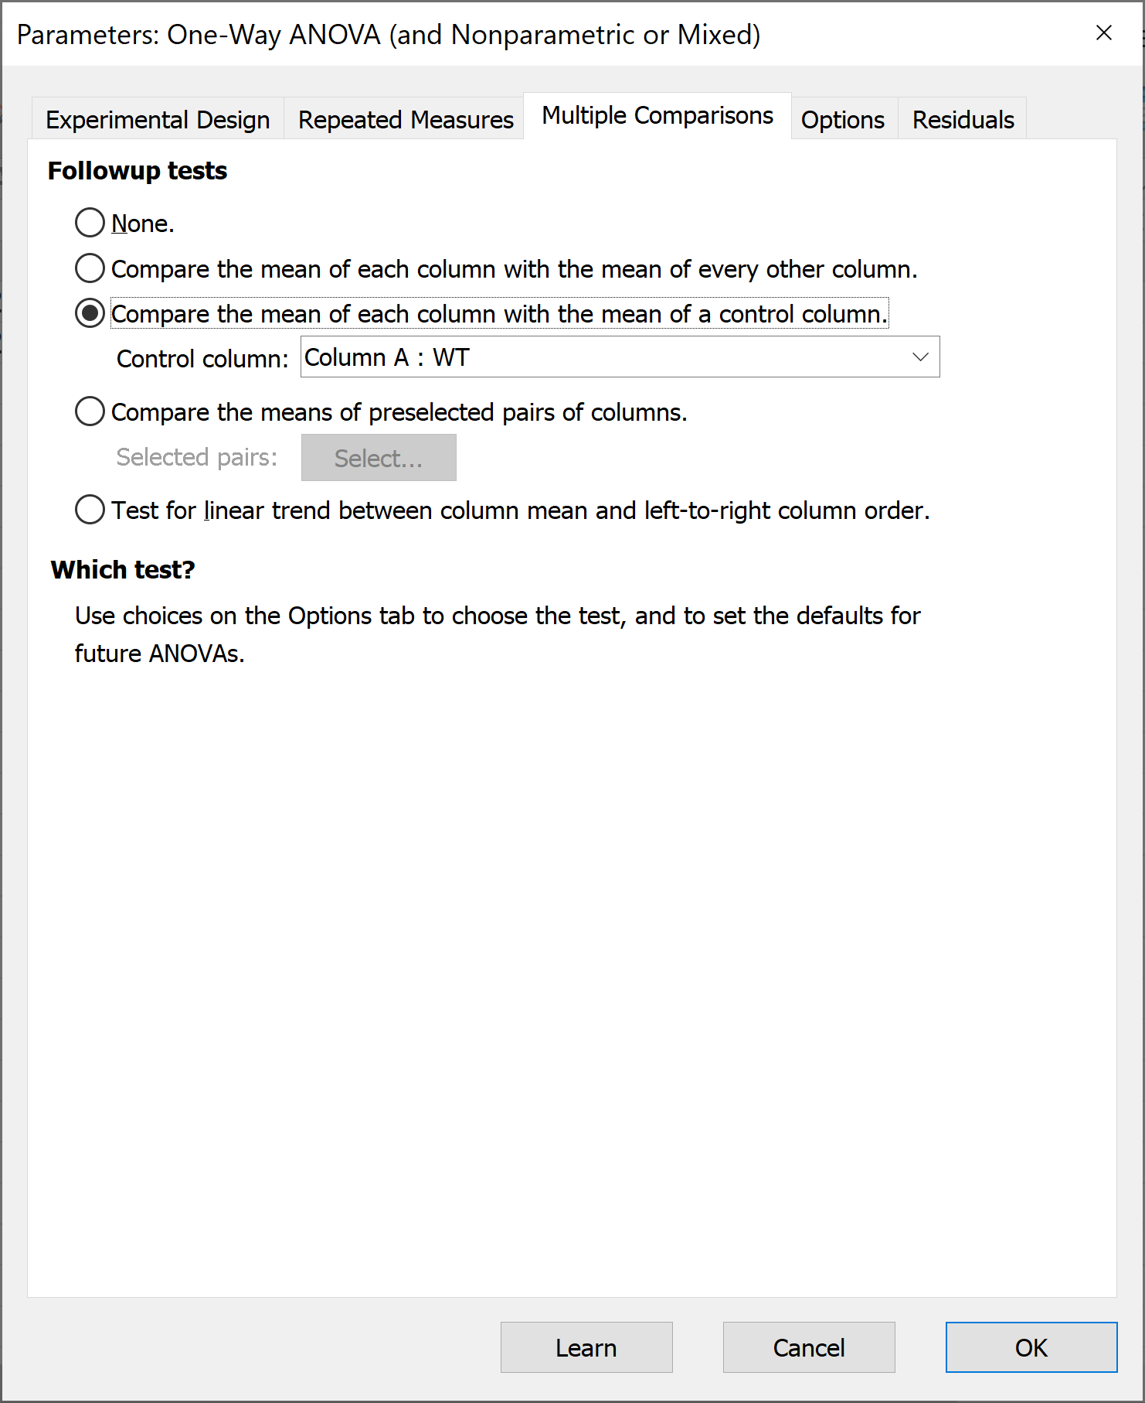

Slide 39
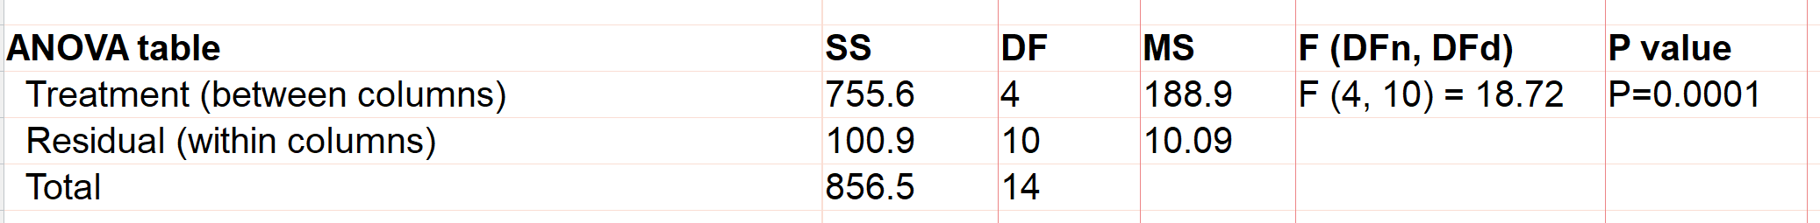
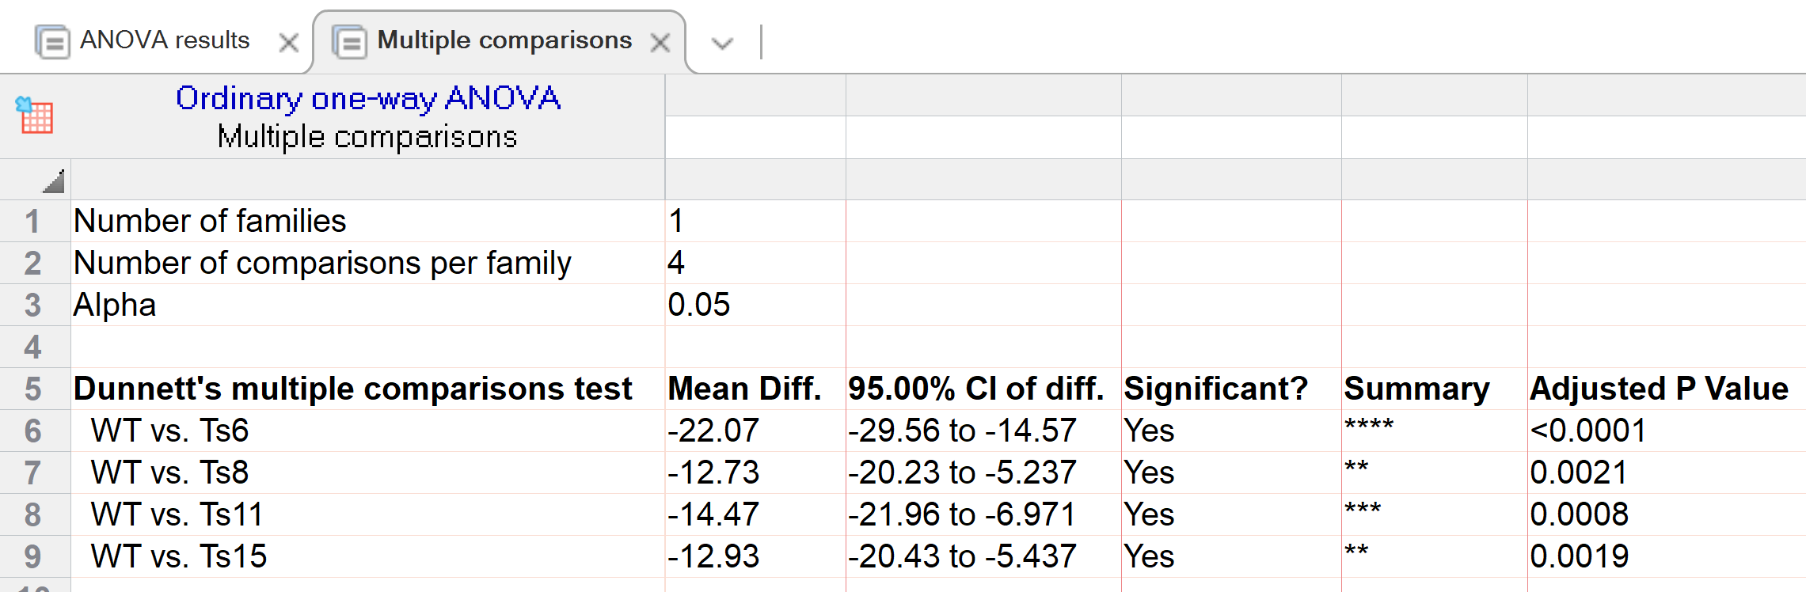

Slide 40
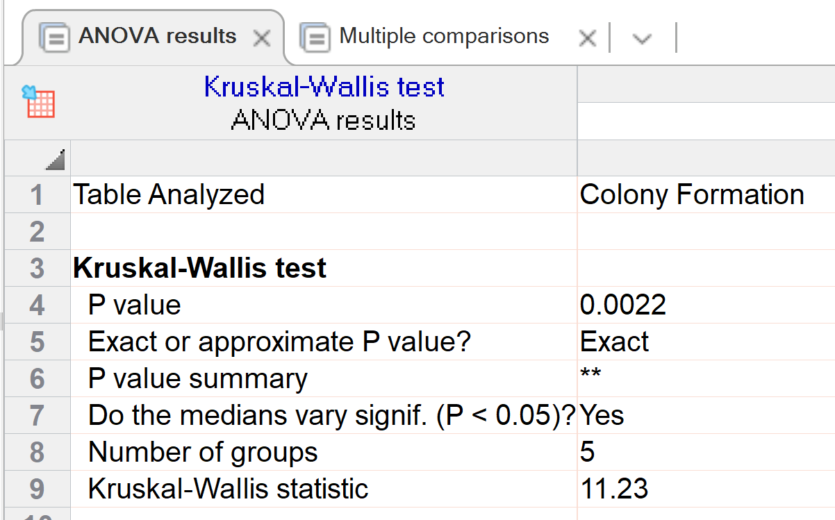
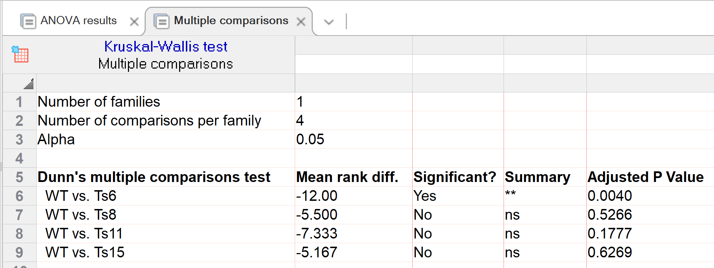

Slide 41
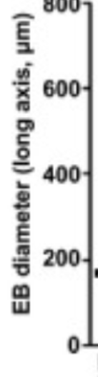
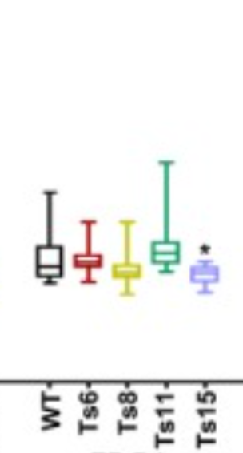
EMBO J. 2016 Nov 2; 35(21): 2285–2300
Box plots of EB diameter of embryoid body (EB) formation. Each box plot was plotted for more than 20 EBs. Boxes indicate the 25th to 75th percentiles and the central bars represent the median. The ends of the whiskers represent the maximum and minimum values. *P < 0.05,
Statistical analysis
The data are shown as the means ± SD. A two‐tailed Student's t‐test was used to analyze significant differences. Welch's correction was used for variance heterogeneity. P < 0.05 was considered significant (*P < 0.05, **P < 0.01). The data analyses were performed using Prism GraphPad software.

Slide 42
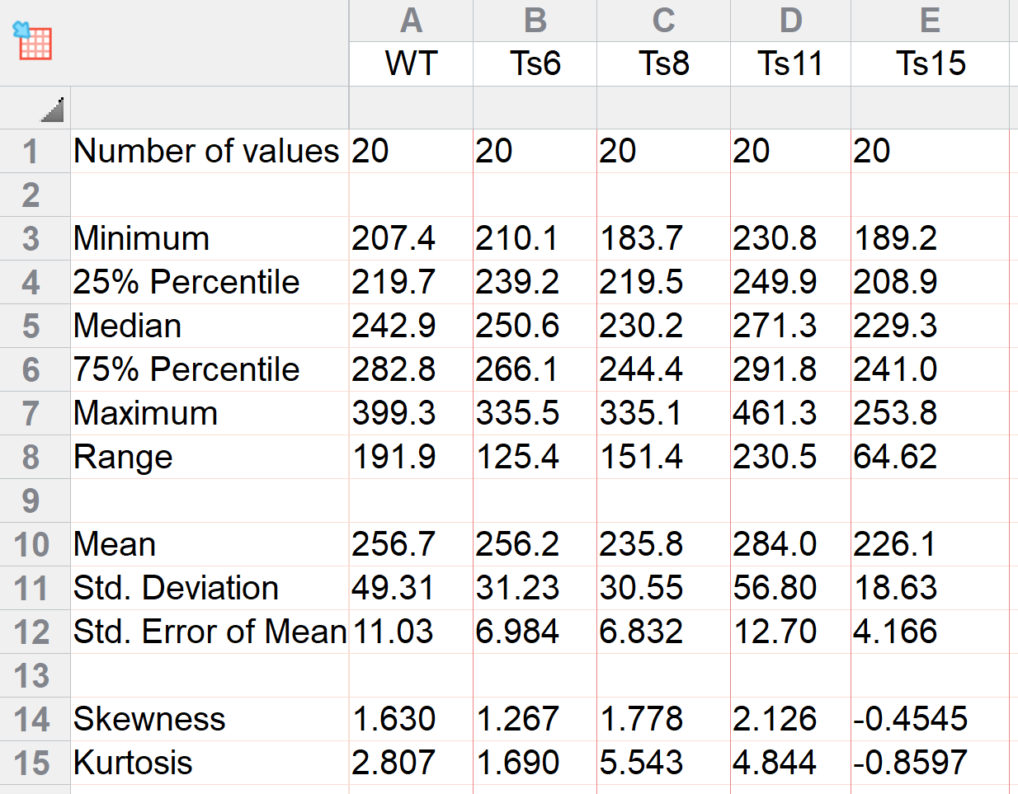
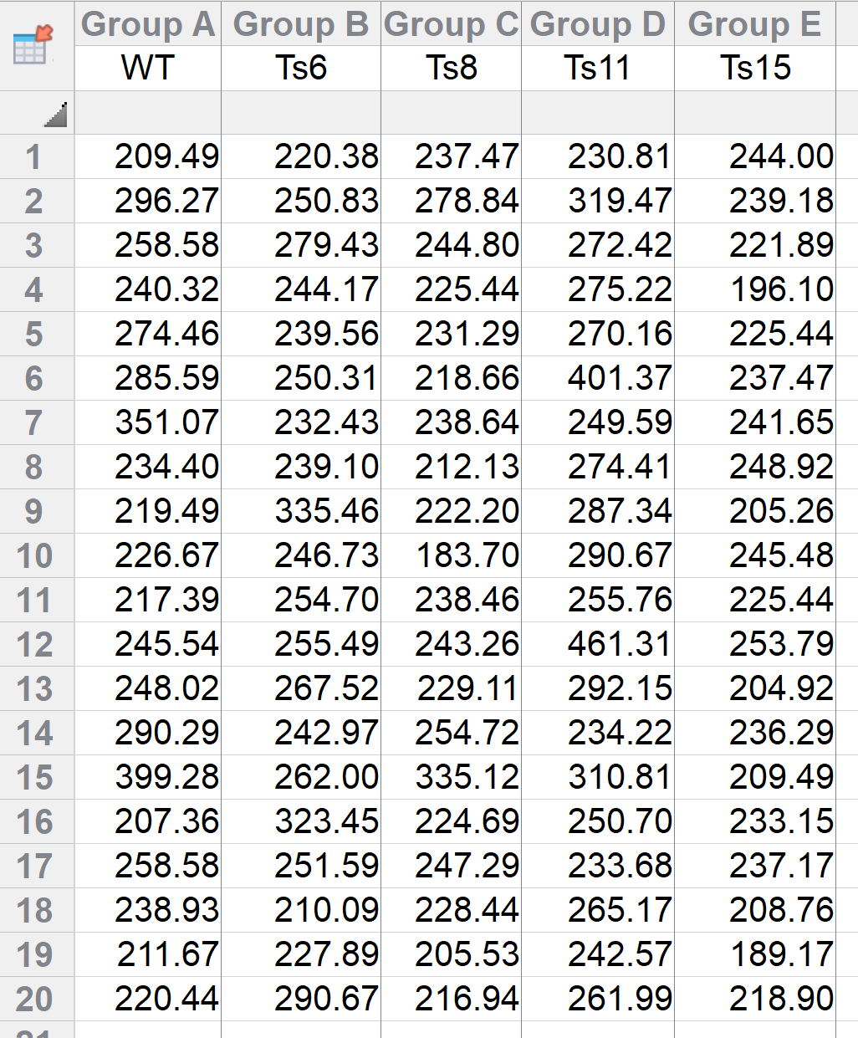
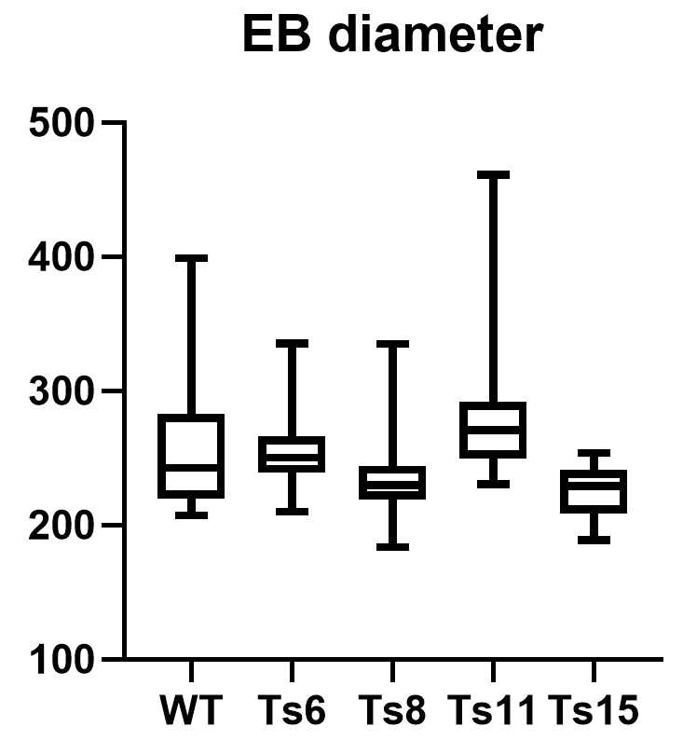
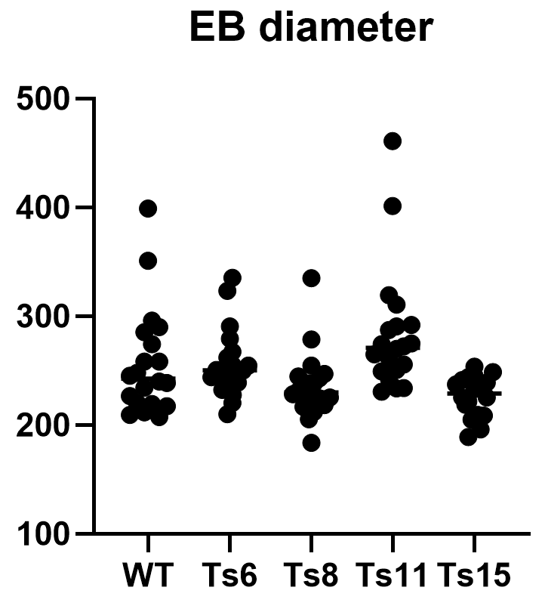

Slide 43
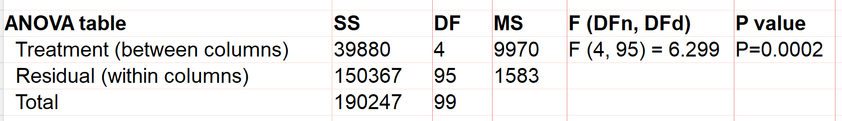

Did a one-way ANOVA, multiple comparisons to WT

Slide 44
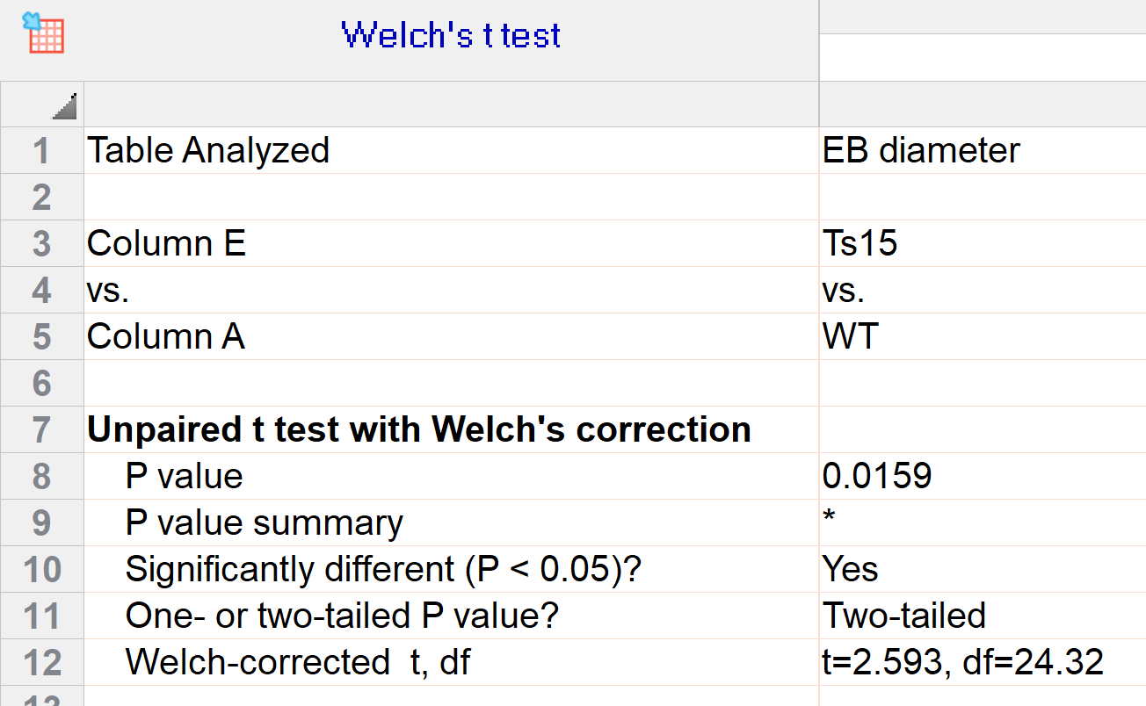

Slide 45
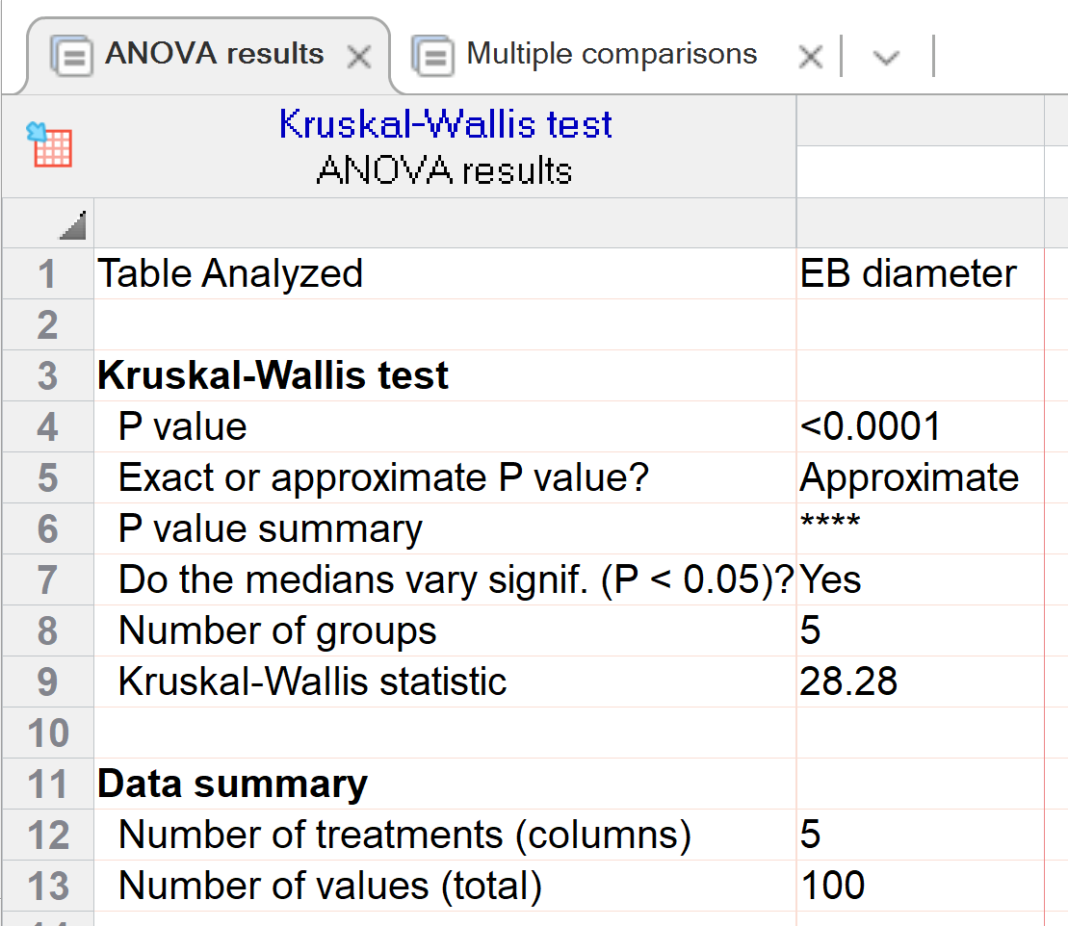
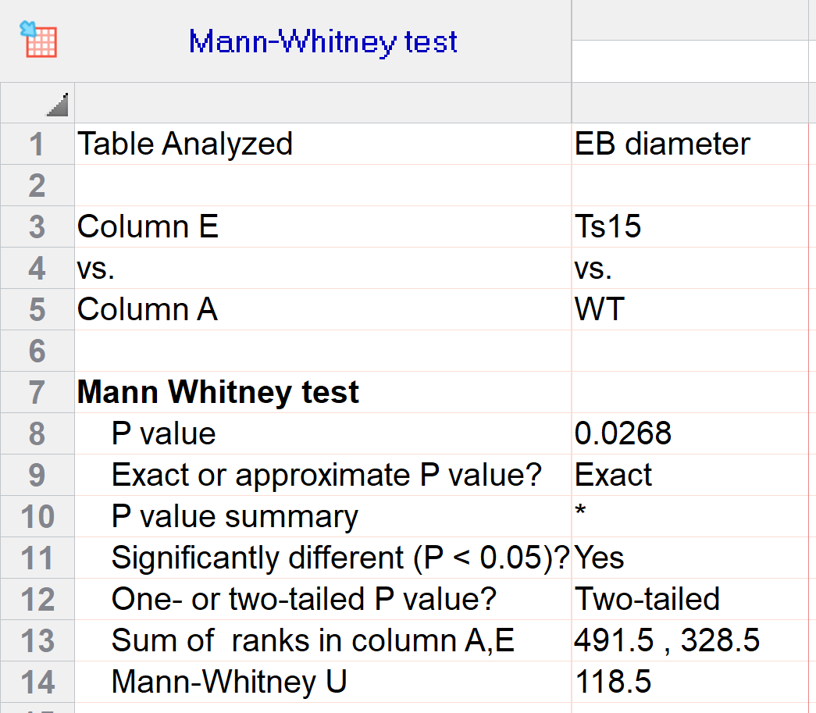
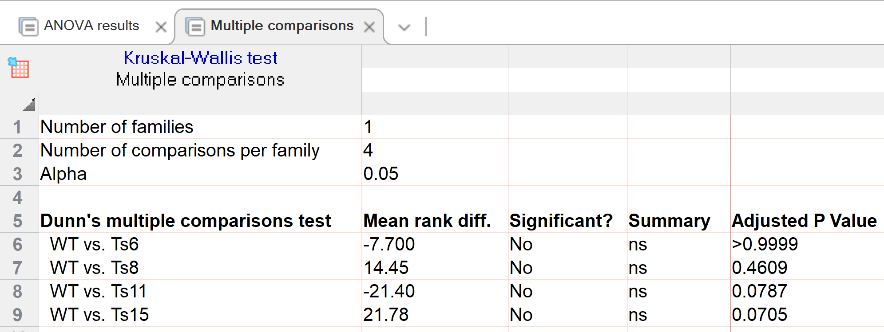

Slide 46
Why is my ANOVA significant but my post-hoc pair-wise t-tests not?
The ANOVA and t-tests are dealing with different questions.
ANOVA looks at variability between groups; t-test looks at differences between means
ANOVA uses the entire sample size; t-tests use subsets of the data
Post hoc tests are more conservative because they attempts to control the overall alpha level to reduce false positive rate

Slide 47

With thanks to John Cleese and Monty Python

Slide 48

p-Hacking
One type of bias, known as “p-hacking,” occurs when researchers collect or select data or statistical analyses until nonsignificant results become significant.
It is a relentless search for p<0.05

Slide 49
p-Hacking
Did not have a priori hypotheses, instead collected a lot of data, looked for differences, and after many tests, finally found a result with p<0.05
Or, did not find p<0.05, so added more subjects until you did.
Or, eliminated “troublesome” data until you find p<0.05
Or, tried various statistical tests until you found one with the correct p-value
Nobel laureate Ronald Coase (British economist and author) once said
“If you torture the data enough, it will confess.”

Slide 50
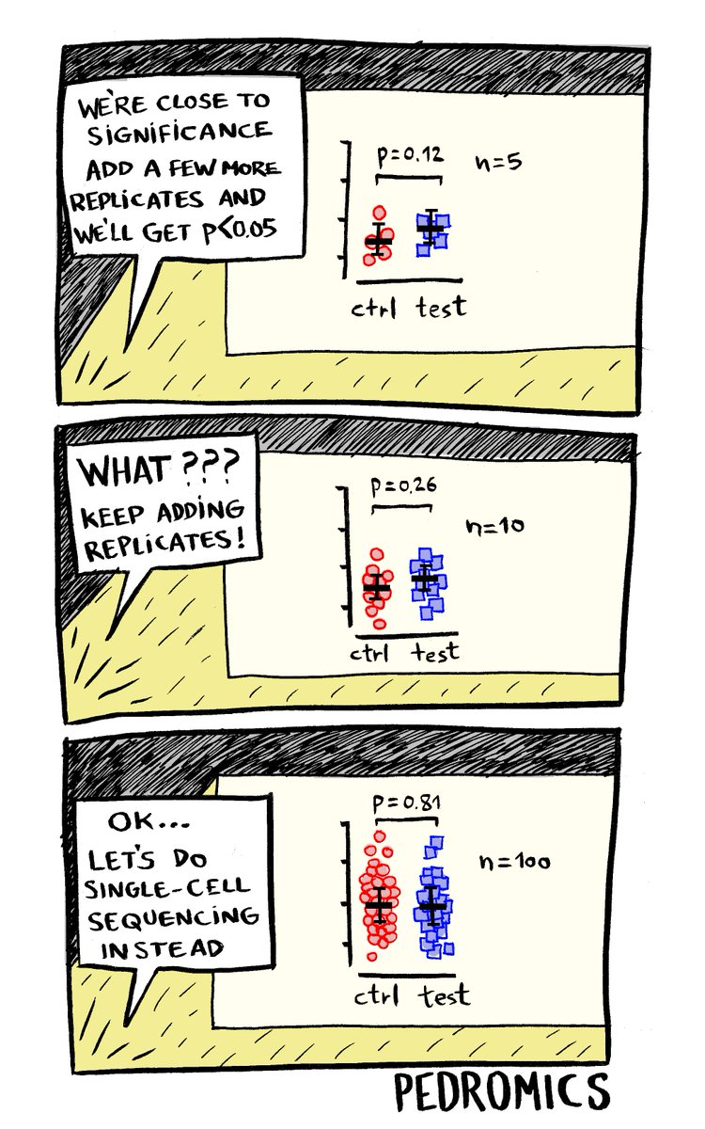
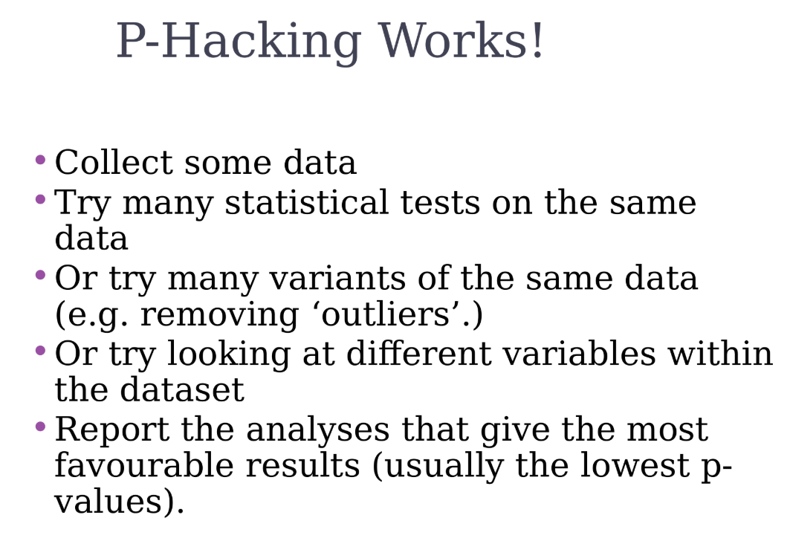

Slide 51
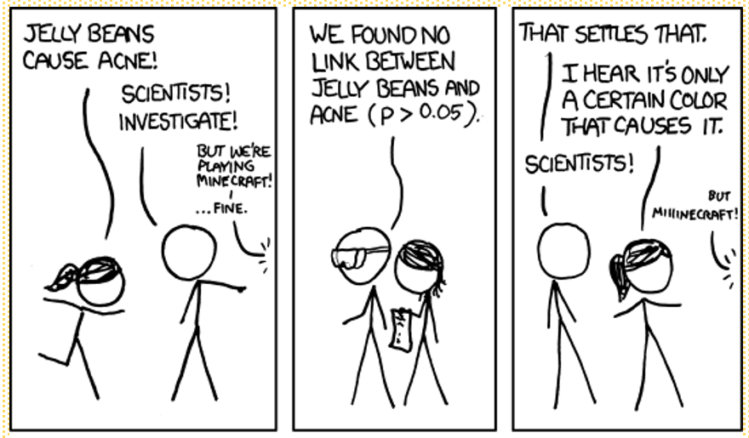

Slide 52
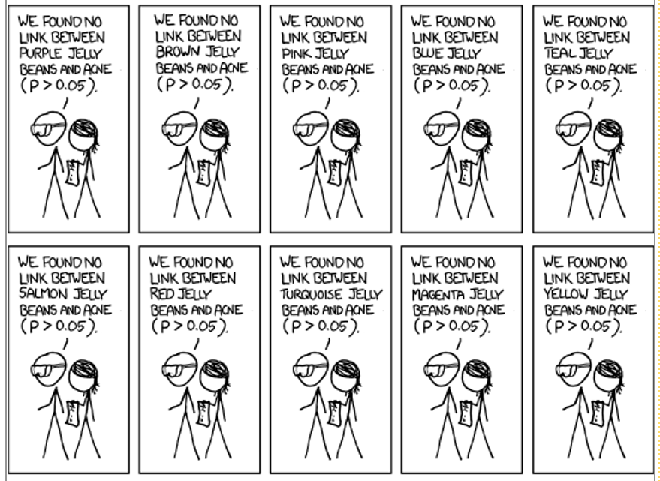

Slide 53
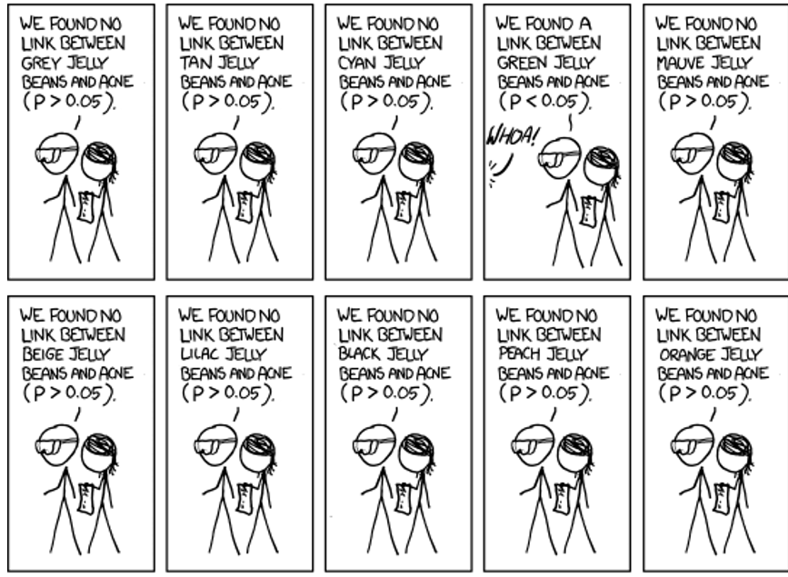

Slide 54
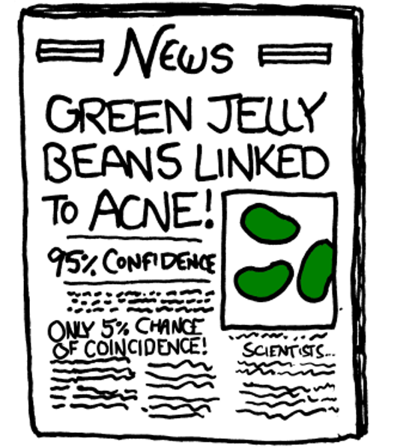

Slide 55
These research behaviors are seemingly encouraged because researchers are rewarded for statistically signiﬁcant ﬁndings (e.g., higher publication rates and, therefore, more publications for promotion)
To ensure that their work is accepted for publication, researchers may take steps to guarantee statistical signiﬁcance…
One solution to the problem of p-hacking is to pre-specify or preregister every aspect of the analysis.
Another is to only analyze data related to a priori hypotheses.

Slide 56
But…
Many datasets are under analyzed; you could miss something useful
Unplanned findings should be presented as hypotheses to be formally tested in future studies
But…

Slide 57
… a Cautionary Tale
A trial, published in 1998, in which beta carotene and vitamin E were tested for lung cancer prevention in 29,000 Finnish men who smoked, those who took vitamin E had 32 percent less prostate cancer. Neither beta carotene nor vitamin E prevented lung cancer. In fact, the men who smoked and took beta carotene were more apt to get lung cancer and die from it than men who didn't take this supplement.
This lead to the Selenium and Vitamin E Cancer Prevention Trial (SELECT), the largest cancer prevention trial ever planned (>35,000 men followed for 12 years at 400 study sites, enrollment started in 2001)
The study ended early in 2008 when the data showed that not only did vitamin E fail to decrease the risk of prostate cancer — it may have actually increased the risk instead
SELECT cost $114 million to conduct

Slide 58
